Slide 1

GitHub Workflow for SAP
SAP Science Meeting
April 7, 2022
Meg Oshima and Eric Fletcher

Slide 2
Motivation
1. Provide suggested workflow
2. Discuss best practices for repositories
3. Discuss best practices for confidential data
Note: based on personal experiences and previous discussions with other SAP members

Slide 3


Git vs GitHub
Version control software
Need to have git (git for Windows) installed locally before using any GUI or service
Cloud-based service
Place to host and manage multiple code repositories
Use with multiple programs and IDEs
Notes:
Git is version control software, github is service

Slide 4


Helpful Terms
Repository (a.k.a. repo): A directory or storage space where you can store code, text, image, or other files for a project
Commit: A “snapshot” of the state of you repository at a given time
Push/Pull: Syncing changes between local computer and server
Branch: A set of code that allows you to make changes in isolation
Notes:
Push and pull from local computer to server - add

Slide 5
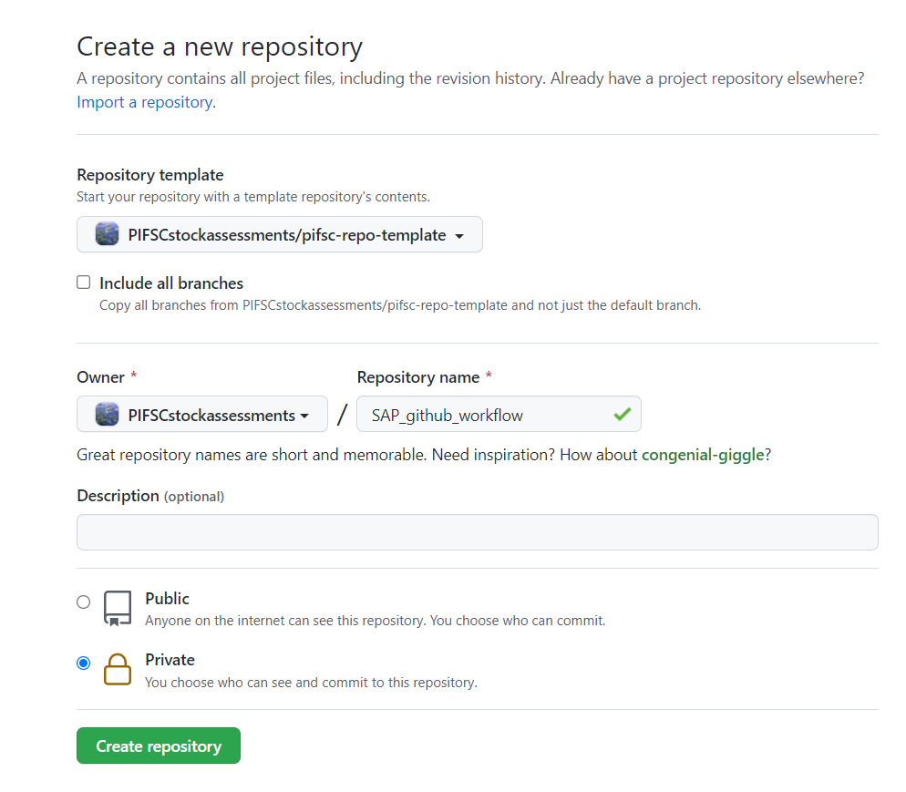
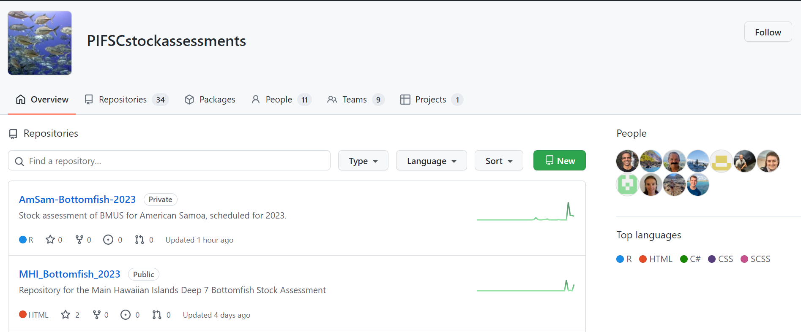
Step 1: Set Up a New Repository
2
1
3
4
PIFSC GitHub
Notes:
Common files for a new repo
README.md (in markdown language, used to provide info about the repo: who, what, why, how)
Gitignore (files to not be tracked in the repo, can be specific files, directories, or files with a specific naming (i.e. .csv)
License.md (legal license for the repo, especially important for packages) – make it a MIT license

Slide 6
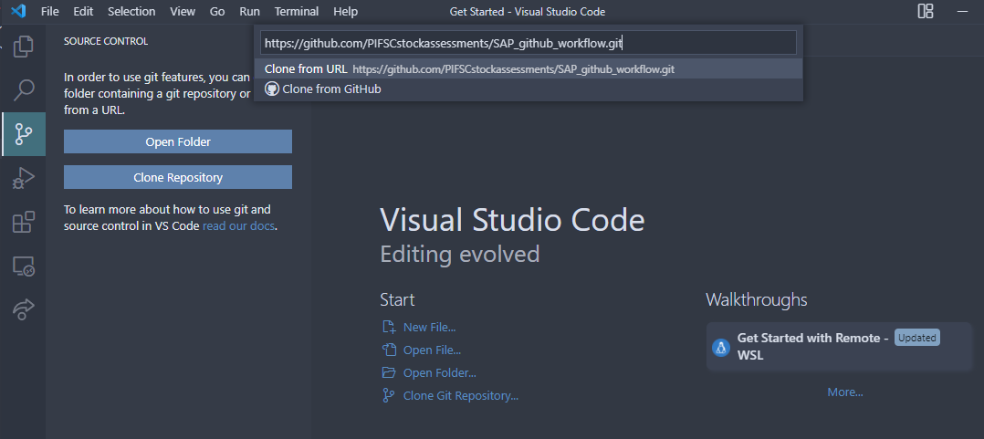
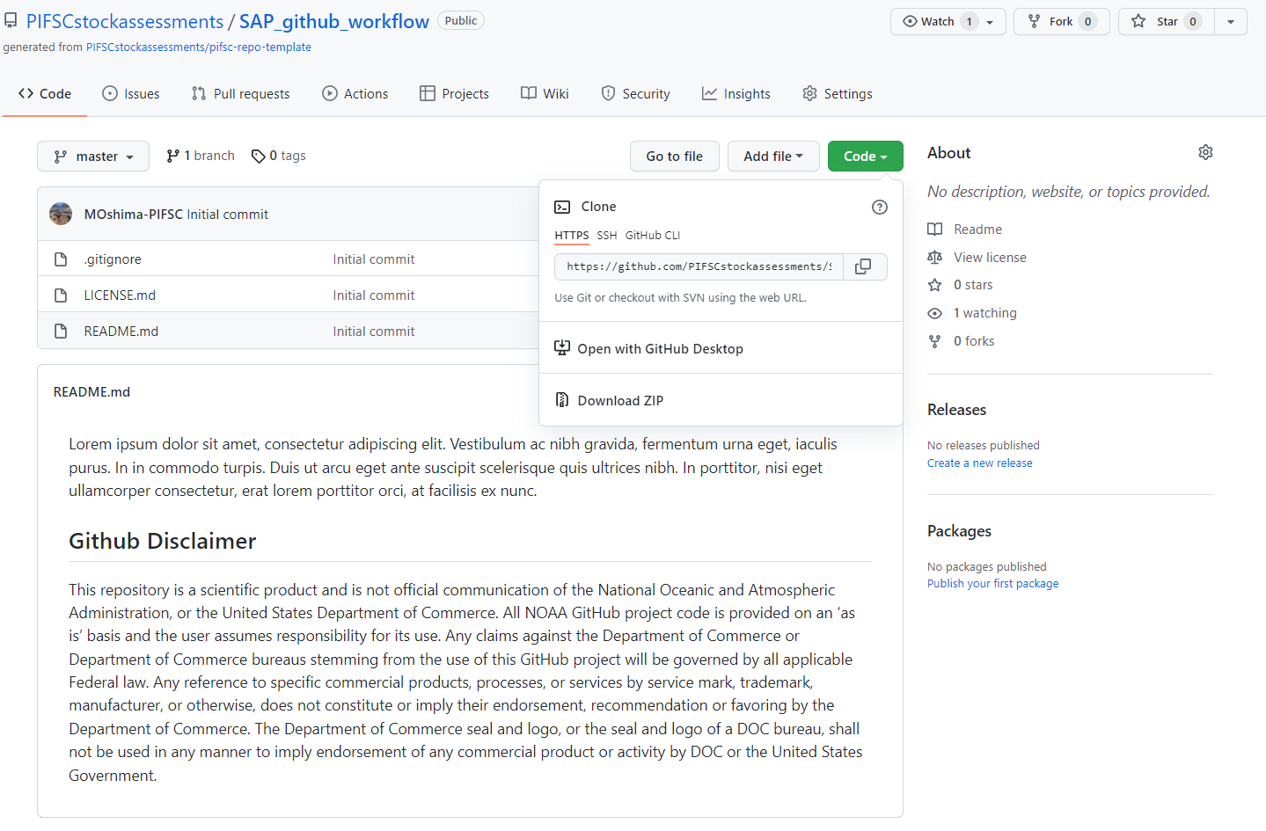
Step 2: Clone Repository to Machine (VS Code)
Notes:
Commit – add commit message – push (green arrow, terminal git push master)

Slide 7
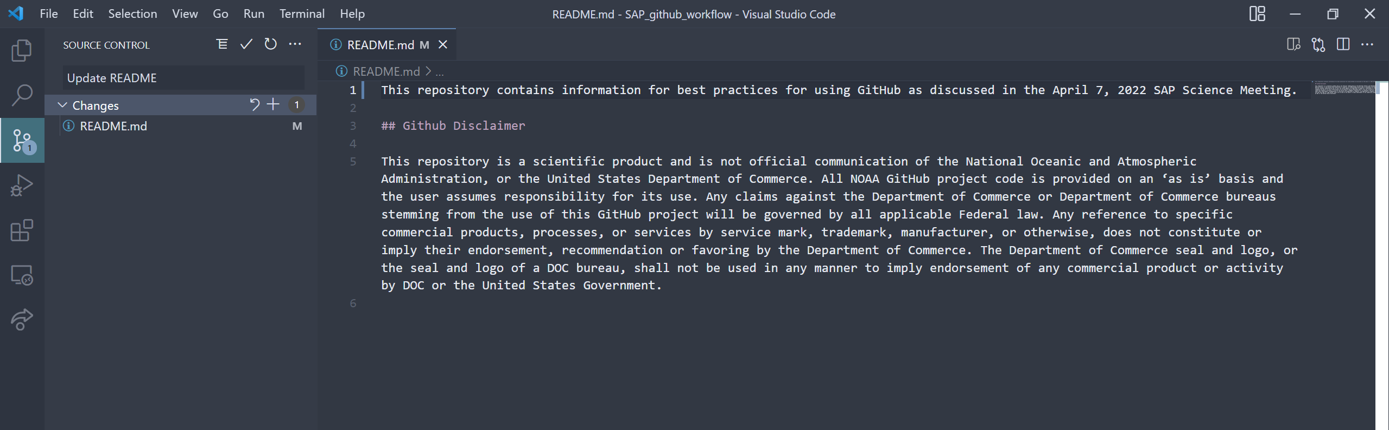
Step 3: Commit & Push Changes (VS Code)
stage changes (+) → add commit message → commit (Shift+Enter) → push changes to repo
Notes:
As a guideline, commit parts of code intended for a specific change.
Commit change and add commit message
Short but descriptive
Push changes to repository
Choose which branch to push to
Can push multiple commits at once
Pull before starting a new session to make sure you have the most updated version

Slide 8
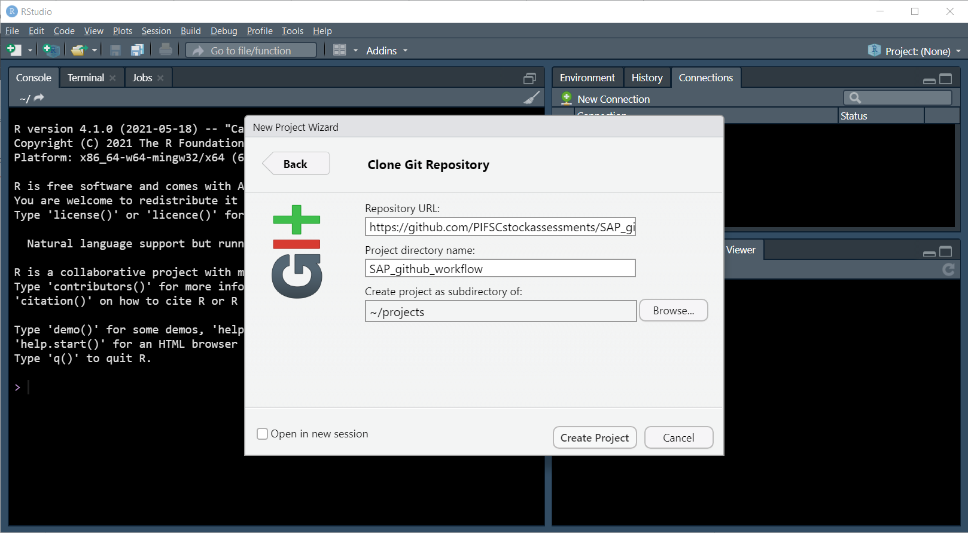
Step 2: Clone Repository to Machine (RStudio)
New Project (Create Project) → Version Control → Git
Notes:
Rstudio – new project – version control (assume git installed) – git – add info –create project

Slide 9
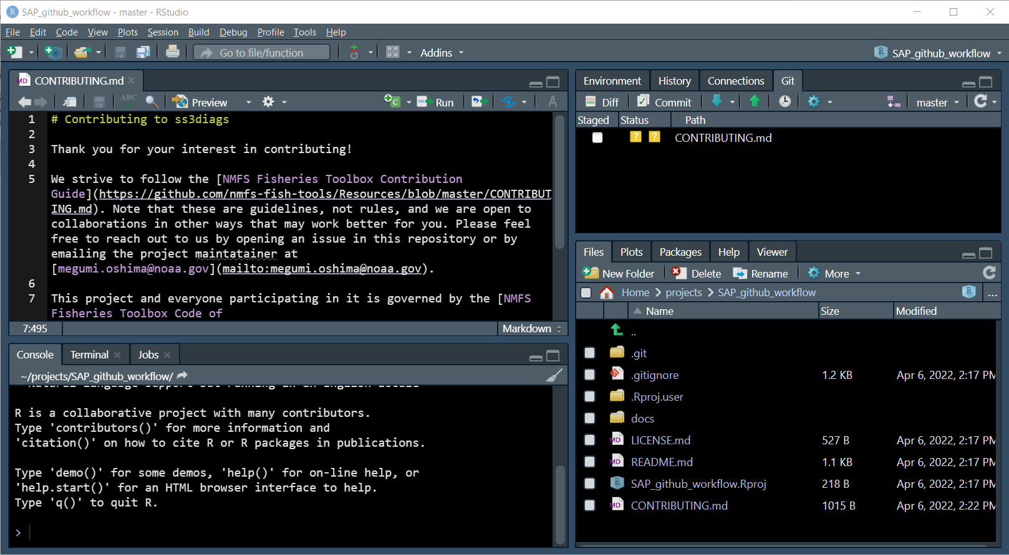
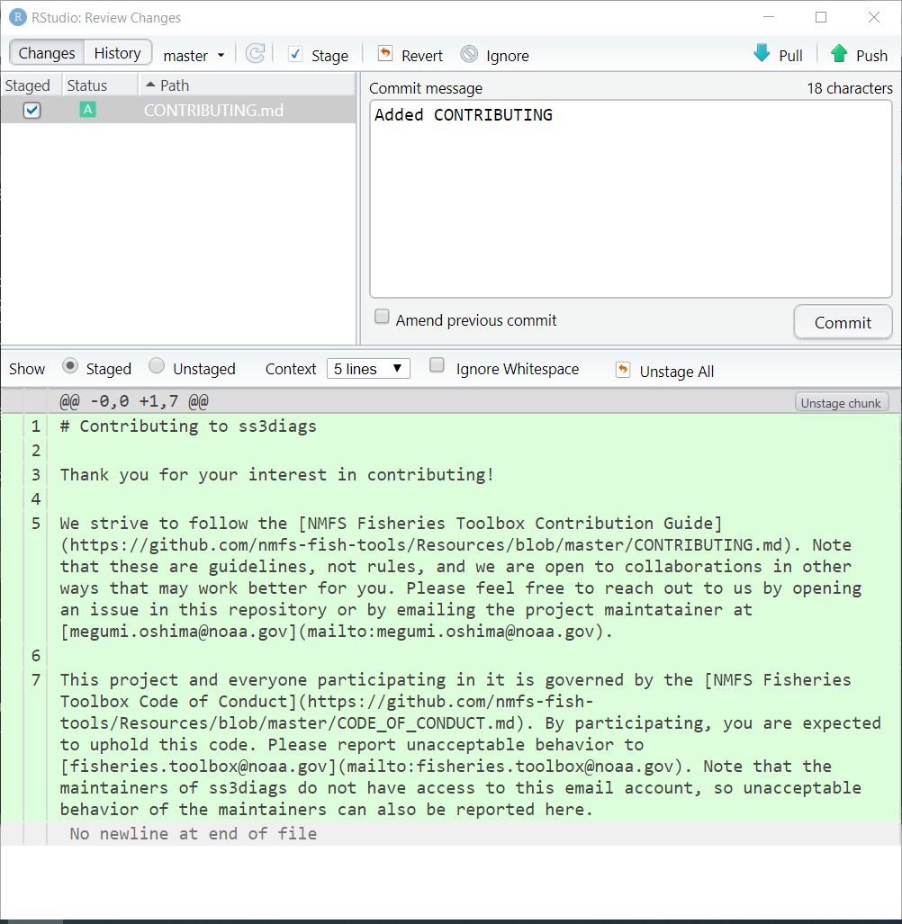
Step 3: Stage & Commit Changes (RStudio)
commit → check files → add commit message → commit
Notes:
As a guideline, commit parts of code intended for a specific change.
Commit change and add commit message
Short but descriptive
Push changes to repository
Choose which branch to push to
Can push multiple commits at once
Pull before starting a new session to make sure you have the most updated version

Slide 10
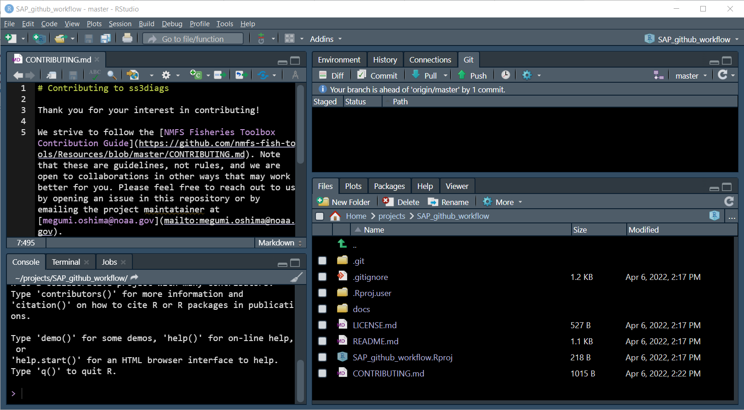
Step 3: Push Changes (RStudio)
git pane → push changes to repo

Slide 11
Troubleshooting Commits
Try pulling changes then push commits
May need to stash changes, pull, then pop stash
Make sure file size isn’t too large (issue with ss files)
If committing multiple files, undo and commit individually
For data analysis workflow, not R package

Slide 12
Using Branches
Data Prep
Main Branch
Data Analysis 1
Data Analysis 2
Notes:
When working with others, use branches
Branches allow someone to work on a section without affecting the main branch
Create a new branch for each major step of development
Data prep, data analysis, model development, results
Integrate branch changes with PRs to main branch

Slide 13
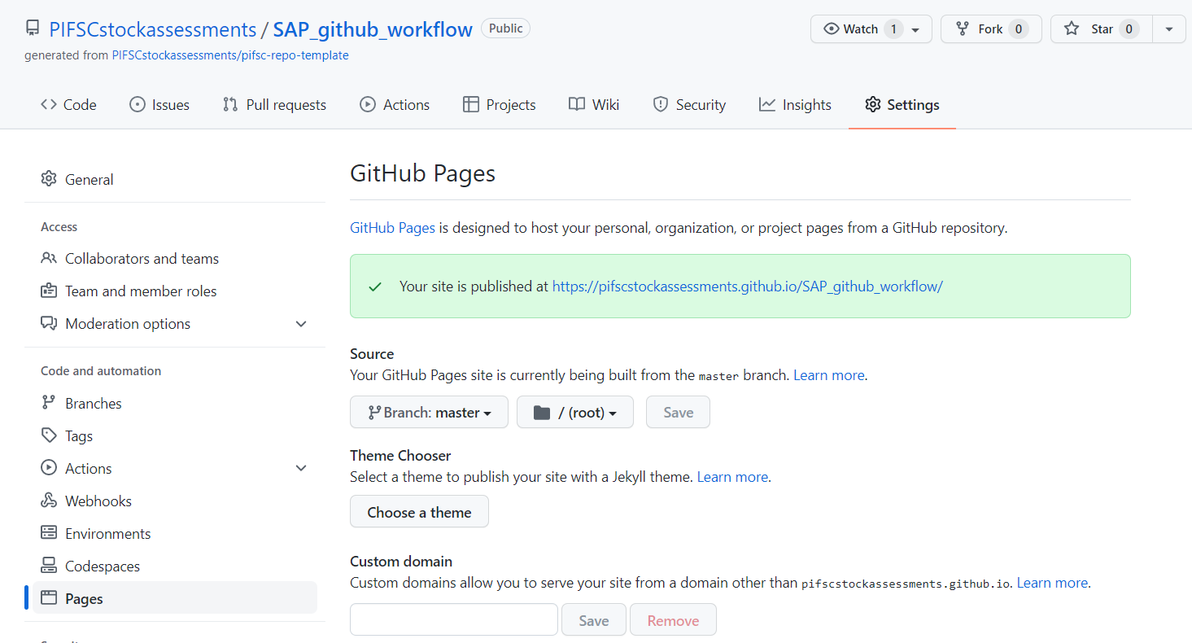
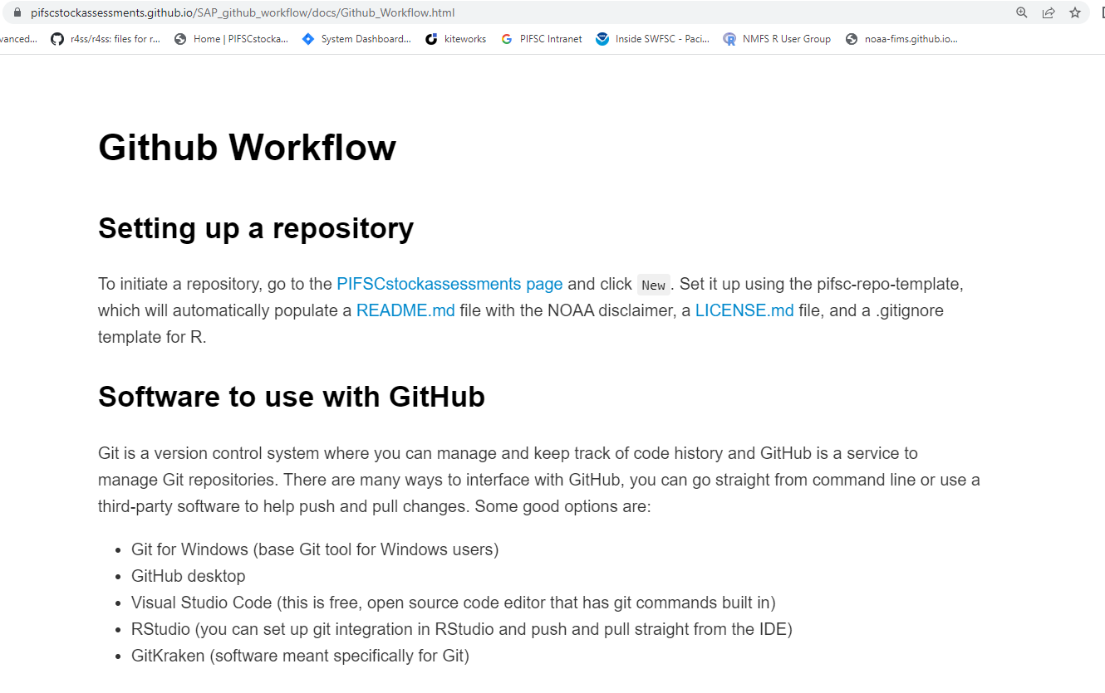
Host Supporting Docs on Repo Website
Notes:
Set up a GitHub Pages for the repo which is a website hosted by github. The benefit of this is that it allows you to host htlm files so you can view .Rmarkdown or .Rmd files as the rendered version not just in the raw file.
To set this up, go to settings and Pages on the left hand panel, then select the branch you want to be the main page and which branch.
{pkgdown} creates a github site for r package

Slide 14


Script Dos and Don’ts
Do:
Don’t:
Split up data, scripts, and outputs into separate folders
Label script files clearly according to their purpose and order if used in a sequence (e.g. Catch_01_prep_data.R)
use relative paths to files (e.g. "./Data/catch.csv")
use RProject
write dates in the file names (e.g. Catch_01012020.R)
set working directory in the script
clear the environment `rm(ls())` within the script
Notes:
For using Rprojects, use the package here for easily navigating through files
Use the gitignore file to keep artifact files (extra ss files), sensitive data, large files, or R environments from being pushed to the repo

Slide 15
Confidential Data
.gitignore file
Separate folder that only contains confidential data
Common filename structure (i.e. *_CON.csv) for all confidential files
R packages such as {keyring} to store credentials
Rule of 3 and 90/10 rule
Remember, the data is confidential but what you do to the data is not, so keep the initial prep script short and create a non-confidential version of the dataset that can be shared on the repo
Notes:
Create a separate folder that only contains confidential data and add this folder to the gitignore file.
Use a common filename structure (i.e. *_CON.csv) for all files that are confidential. This allows you to add that file name to the gitignore file, creating a second check that it will not be pushed to the repository as well as helping to identify that data set as confidential to other collaborators.
Use R packages such as keyring to store credentials such as username and passwords that you do not want to write out in your code
Rule of 3 – must have at least 3 observations to show statistics
90/10 rule – no entity can represent more than 90% of the total
Remember, the data is confidential but what you do to the data is not, so keep the initial prep script short and create a non-confidential version of the dataset that can be shared on the repo
Options:
-extreme – no data available (Nico, Eric, John are more risk averse)
-partial data – conf is off but non-is on github

Slide 16
Discussion: Hosting Partial Data on Repo?
Pro:
Con:
Users can run portions of the analysis without contacting anyone
Increases transparency of analysis
Report metrics of data suppressed for confidentiality reasons
Potential to accidentally push confidential data to repo
Might be confusing to have some data available and others not
Notes:
Need more than 3 unique operators and within an area
Can be hard to get to non-confidential version of data
Concern is temporary file needs to be updated
The way they have doing it is have a zip data file with everything on google drive and then download that and use that in your script
Nico keeps confidential data in a completely separate directory, makes sure it doesn’t get pushed

Slide 17
Resources
Confidentiality Confidence Builder
Software to use GitHub
VS Code
Github Desktop
GitKraken
Using Git and Github with Rstudio

